Slide 1
What is Usability Testing?
Usability.gov:
“Usability testing refers to evaluating a product or service by testing it with representative users.
Typically, during a test, participants will try to complete typical tasks while observers watch, listen and takes notes.
The goal is to identify any usability problems, collect qualitative and quantitative data and determine the participant's satisfaction with the product.”

Slide 2
Why Test?
Identify usability issues early on. Work the fixes into development cycles.
Identify potential new features for current or later versions.
Reduce support needed for the product
Gain knowledge about your user-base
Have quantitative and qualitative data to back up design decisions as you go.
Create a better product.

Slide 3
Pre-design Testing
Test on sites which are similar to what you intend to build
Conduct a competitive analysis
R.O.T. (Redundant, Outdated, Trivial) Analysis

Slide 4
Who does the testing?
“Testing one user is 100 percent better than testing none” - Steve Krug
Test various different user groups if they exist
Personas
At least 4 users of each user type
Can conduct additional testing if results are inconclusive for a group

Slide 5
Conducting Tests
Generate test scripts (actions to be performed)
Test one user at a time
15-20 questions per hour with discussion follow-up afterward
Don't frame or lead with your tasks
Encourage testers to think out loud
Don't help the tester
If you can have users test on their own computer, that's even better

Slide 6
Documenting Results
Take notes
What interactions took place
How did the tester scan pages
Capture the screen if possible
Video record sessions if possible
Recording form on usability.gov

Slide 7
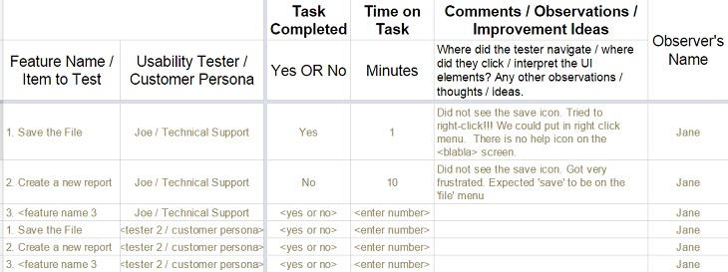
Test Analysis
Organize results for analysis
Look for trends
Organize results for presentation

Slide 8
Reacting to Test Results
Update designs based on tester feedback
Card sorting exercises
Is your information architecture (IA) working?
When proposing a new design or feature, use visual representations

Slide 9
What's not Usability Testing?
Focus groups
Polls and surveys
Feedback emails
QA Testing

Slide 10
Additional Resources
https://www.nngroup.com/articles/task-scenarios-usability-testing/

Slide 11
Exercise - Conduct Usability Testing
Pick a site
Generate 5 tasks plus their general impressions
Pick site without login required
Use stopwatch
Take notes – interactions (clicks, scrolls, etc)

